Slide 1
Cisco Packet tracer project
By Oscar Saxon

Slide 2
Project Task and idea
We have been given the task of creating a network in cisco packet tracer.
I have designed mine for a small company with two different branches meaning in the same building with one focusing on sales and the other focuses on marketing.
This means that both branches will have to each have their own sub-networks as well as both branches being able to communicate with each other

Slide 3
Design
To complete this idea the network will need:
A switch for each branch allowing each device within each branch to communicate with eachother.
A router in each branch allowing devices from each branch to communicate with devices from the other branch
Set security within the network allowing only users who should be able to use the network from being able to

Slide 4
Configurations
Added new hostnames for both switches = Subnet1Switch, Subnet2Switch
Added ConsolePassword = Password1, Added enableSecret = Password2 and added Telnet Password = Password 3

Slide 5
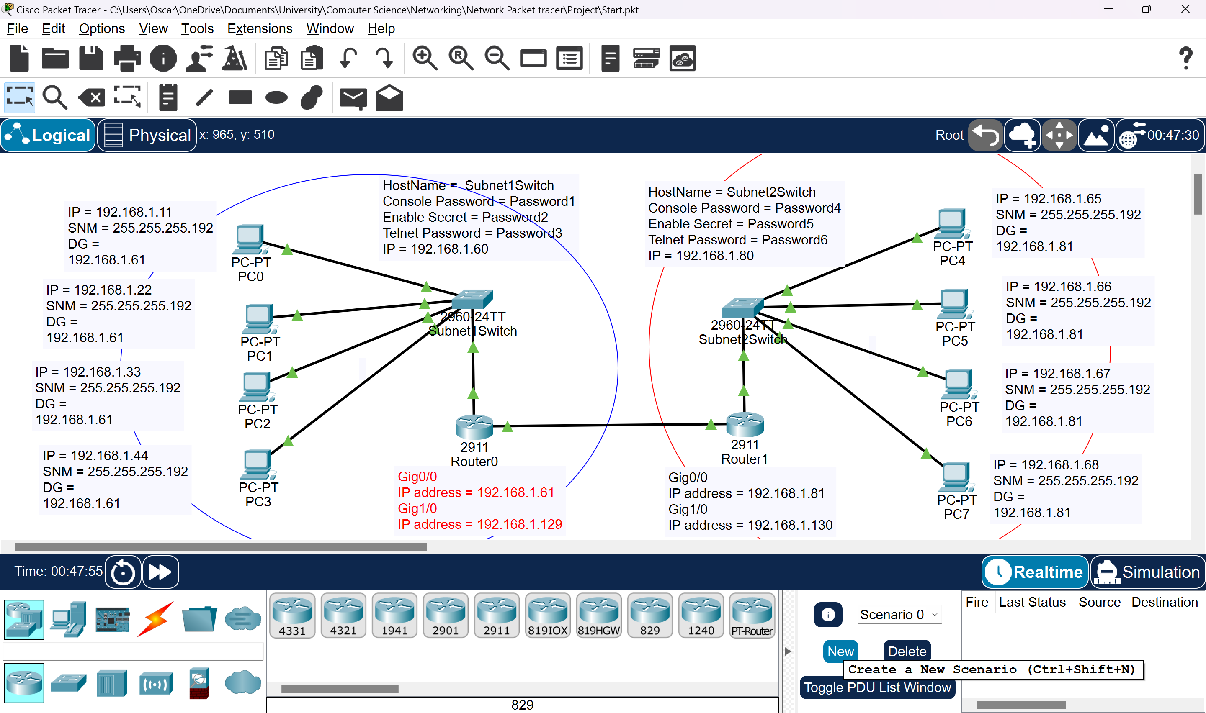
Network Topology

Slide 6
Subnetting
Subnetting 192.168.1.0
Subnet Mask = 255.255.255.192
Sn1
IP = 192.168.1.1 – 192.168.1.64
Sn2
IP =192.168.1.65 – 192.168.1.128
Sn3
IP = 192.168.1.129 – 192.168.1.192

Slide 7
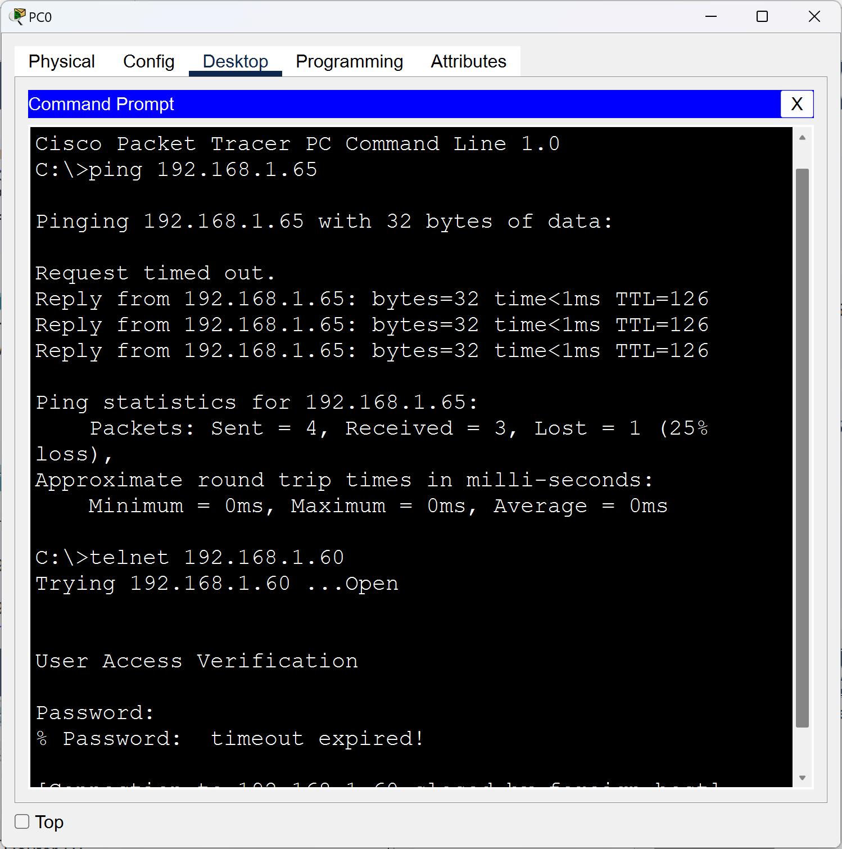
Ping and Telnet PASSWORD

